Slide 2
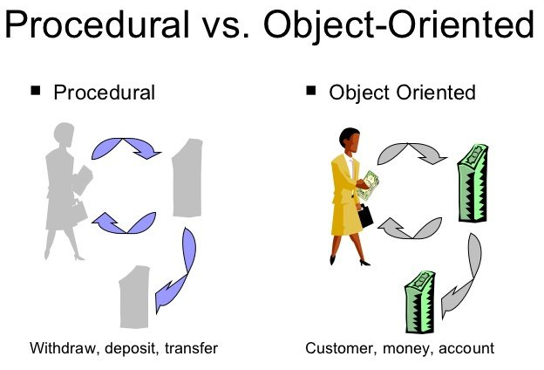
Java Programming

Slide 3
Java Programming – Unit 1
Procedural and Object Oriented Programming Paradigm
What is paradigm?
The generally accepted perspective of a particular discipline or
It comprises of beliefs, concepts and ideas that form a framework to approach and engage with other people.
Programming process
There are several alternative approaches to the programming process.
Two of the most important approaches are :
procedural programming and
object-oriented programming.
What is Programming ?

Slide 4
Java Programming – Unit 1
What is Computer Programming ?
Computer Programming is a creative process carried out by programmers to instruct a computer on how to do a task.
A program is a set of instructions that tells a computer what to do in order to come up with a solution to a particular problem.
There are a number of alternative approaches to the programming process, referred to as programming paradigms.
Different paradigms represent fundamentally different approaches to building solutions to specific types of problems using programming.

Slide 5
Java Programming – Unit 1
Procedural Programming
Procedural programming uses a list of instructions to tell the computer what to do step-by-step.
Procedural programming relies on procedures, also known as
routines or
subroutines.
Or functions or methods.
A procedure contains a series of computational steps to be carried out. Procedural programming languages are also known as top-down languages.
Examples of procedural languages include
Fortran, COBOL and C, which have been around since the 1960s and 70s.

Slide 6
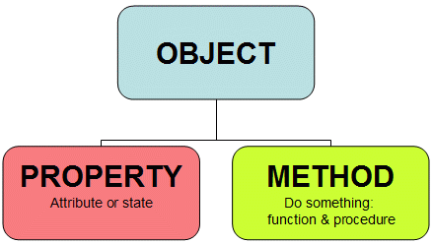
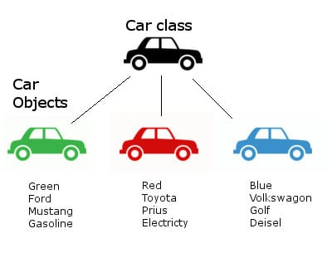

Slide 7
Java Programming – Unit 1
Object-Oriented Programming
Object-oriented programming, or OOP, is an approach to problem-solving where all computations are carried out using classes & objects.
Class is a blueprint of an entity.
Objects are the basic units of object-oriented programming.
A simple examples of a class would be a Car, employee, book.
Logically, you would expect a book to have a no, title, price.
This would be considered a data members (state) of the book.
You would also expect a book to have some properties, such as issue, return, search. This would be considered a methods of the book.

Slide 8
Java Programming – Unit 1
Object-Oriented Programming
Object-oriented programming, or OOP, is an approach to problem-solving where all computations are carried out using classes & objects.
Class is a blueprint of an entity.
Objects are the basic units of object-oriented programming.
A simple examples of a class would be a Car, employee, book.

Slide 9
Java Programming – Unit 1
Object-Oriented Programming
A simple examples of a class would be a student, employee, book.
Logically, you would expect a book to have a no, title, price.
This would be considered a data members (state) of the book.
You would also expect a book to have some properties, such as issue, return, search. This would be considered a methods of the book.

Slide 10
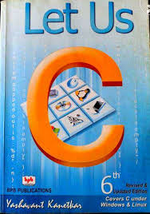
Java Programming – Unit 1
Object-Oriented Programming
Object is an executable thing of a class.
Object has state ie properties and Methods
Book is class
No c101 is object
Name: Let us C
Author : Yashwant kanitkar
Price 250
Properties:
Issue
Return
Reference
Reserved

Slide 11
Java Programming – Unit 1
A method in object-oriented programming is like a procedure in procedural programming.
What is the difference between method in procedural and OOP programming?
The key difference here is that, in OOP the method is part of an object.
Non-static methods are called using object of class.
In object-oriented programming, you organize your code by creating objects, and then you can give those objects properties and you can make them do certain things.
A key aspect of object-oriented programming is the use of classes.
A class is a blueprint of an object.
You can think of a class as a concept, and the object as the means of implementing this concept.

Slide 12
Java Programming – Unit 1
Key Differences between Procedural & OOP
One of the most important characteristics of procedural programming is that it relies on procedures that operate on data - these are two separate concepts.
In procedural programming the functions can access local and global the variables.
In object-oriented programming, data and procedures are bundled into objects.
OOPs makes it possible to create more complicated behavior with less code.
The use of objects also makes it possible to reuse code.
Once you have created an object with more complex behavior, you can use it anywhere in your code.
Let's look at a simple example of this.

Slide 13



Slide 14
Java Programming – Unit 1
You want to write a program that plays a song. Your band playing the song will have four members, and you start off by given each of them a name:
myband = ('John,' 'Paul,' 'George,' ‘Mak')
Now select a song:
mysong = “xxxxxx yyyyyy”
If your band has to play above song, you need two more things.
First, you need to have the lyrics and the notes of the song.
Second, each band member needs to know what to do: perform vocals,
play a particular instrument or both.

Slide 15
Java Programming – Unit 1
In procedural programming you will need to include all the
text and notes in the program so the band members can play it.
However, you want to have another band play the song in another program.
In procedural programming,
you could copy and paste the code into another program so there is no need to manually type the same text again.
However, why not save the text into a separate file and every time your band - or any band for that matter - wants to play that song, you simply call up the file.
ie create an object
That way, your code for the song itself never needs to get duplicated.

Slide 16
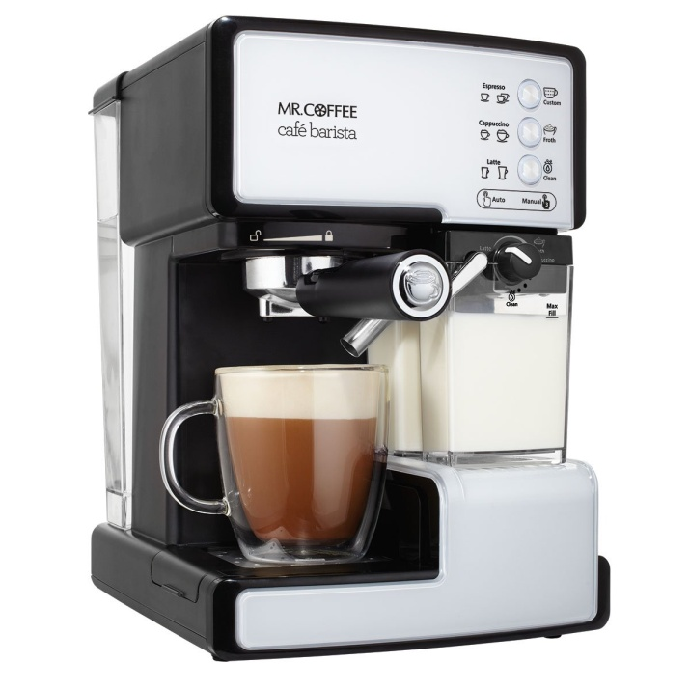

Java Programming - History of Java
In the early 1990's, putting intelligence into home appliances was thought to be the next "hot" technology.
Examples of intelligent home appliances:
Coffee pots and lights that can be controlled by a computer's programs.
Televisions that can be controlled by an interactive television device's programs.

Slide 17


Java Programming - History of Java
Anticipating a strong market for such things, Sun Microsystems in 1991 funded a research project (code named Green) whose goal was to develop software for intelligent home appliances.
An intelligent home appliance's intelligence comes from its embedded processor chips and the software that runs on the processor chips.
Appliance processor chips change often because engineers continually find ways to make them smaller, less expensive, and more powerful.
To handle the frequent turnover of new chips, appliance software must be extremely portable.

Slide 18
Java Programming - History of Java
Originally, Sun planned to use C++ for its home appliance software,
but they soon realized that C++ was less than ideal because
it wasn't portable enough and
it relied too heavily on hard-to-maintain things called pointers.
Thus, rather than write C++ software and fight C++'s inherent deficiencies, Sun decided to develop a whole new programming language to handle its home appliance software needs.

